Slide 1
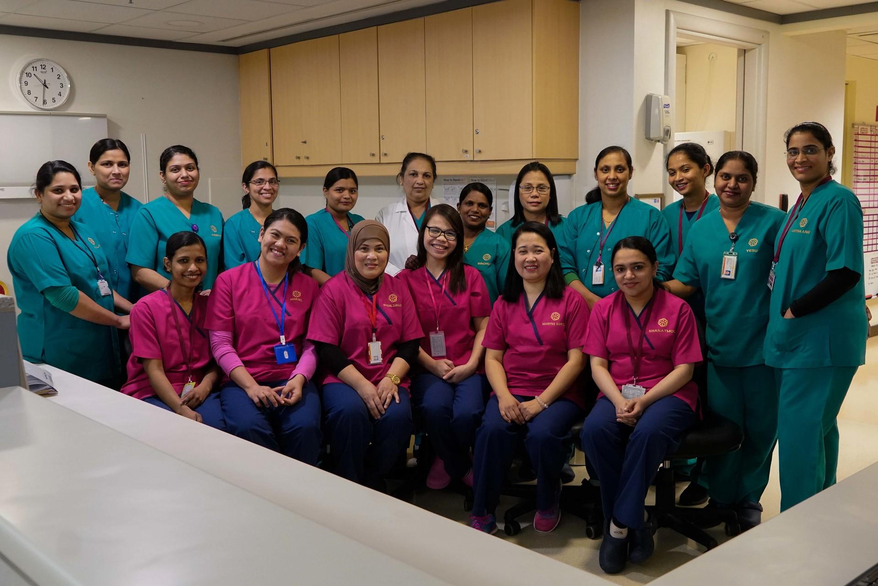

Credit: ICAP/Sven Torfinn
NIGHTINGALE CHALLENGE

Slide 2
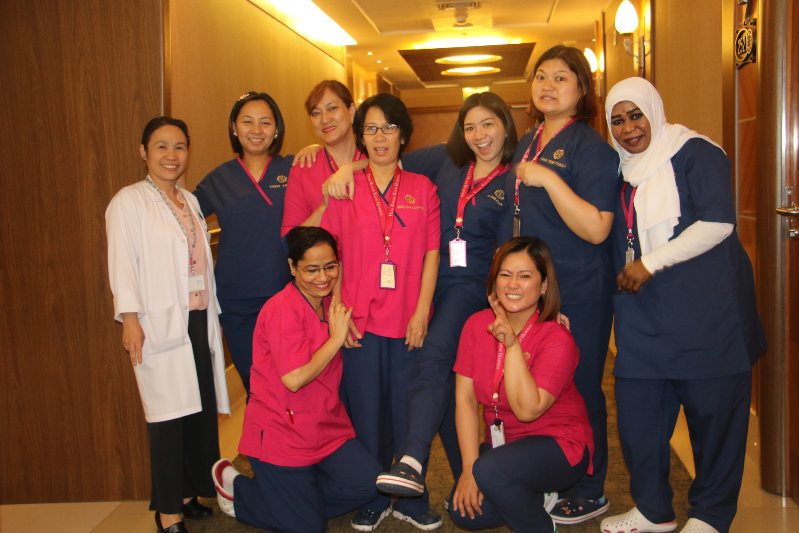


Why 2020?
• 2020 has been declared by the World
Health Organization as the Year of the
Nurse and the Midwife
• 2020 celebrates the 200th anniversary
of the birth of Florence Nightingale:
nurse, innovator, reformer and leader
of improved health care.
Triple impact
24 million nurses and midwives globally – half the professional health workforce
Systematically undervalued and unable to work to their full potential
Triple Impact – improve health, promote

Slide 3
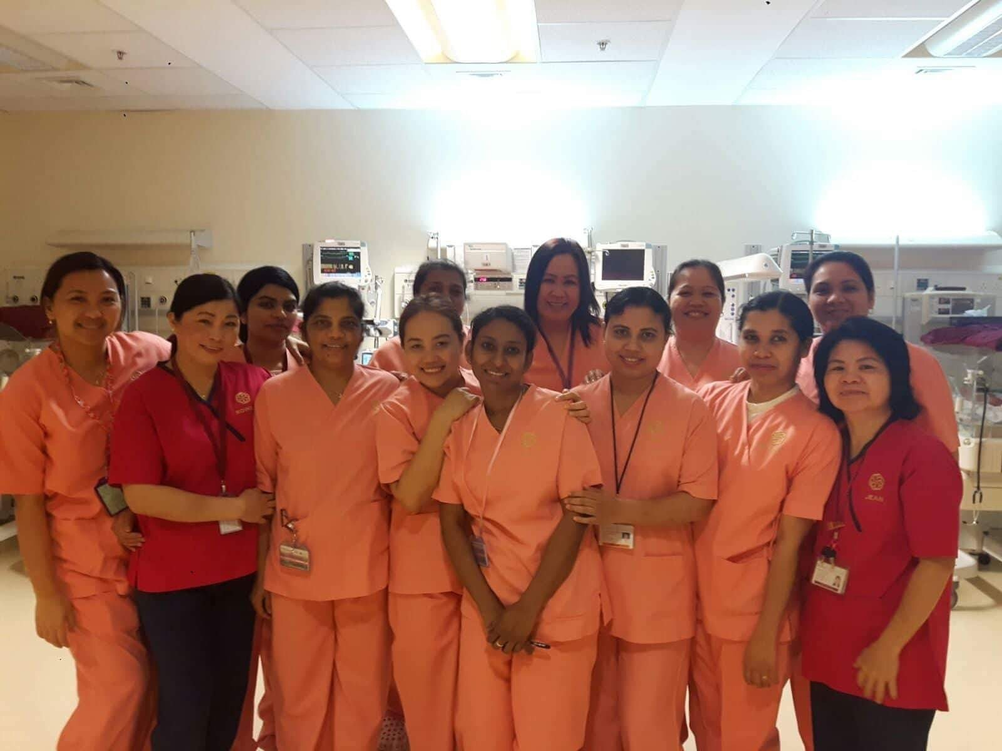
Our aim: to improve health globally by raising the profile and status of nursing.
Benefits for nurses and midwives
♠Extend their knowledge, skills and leadership
♠Develop their professional networks exposure to global health policy making
♠ Feel valued by their organizations
♠ Be in a strong position to take the next step in their careers.

Slide 4
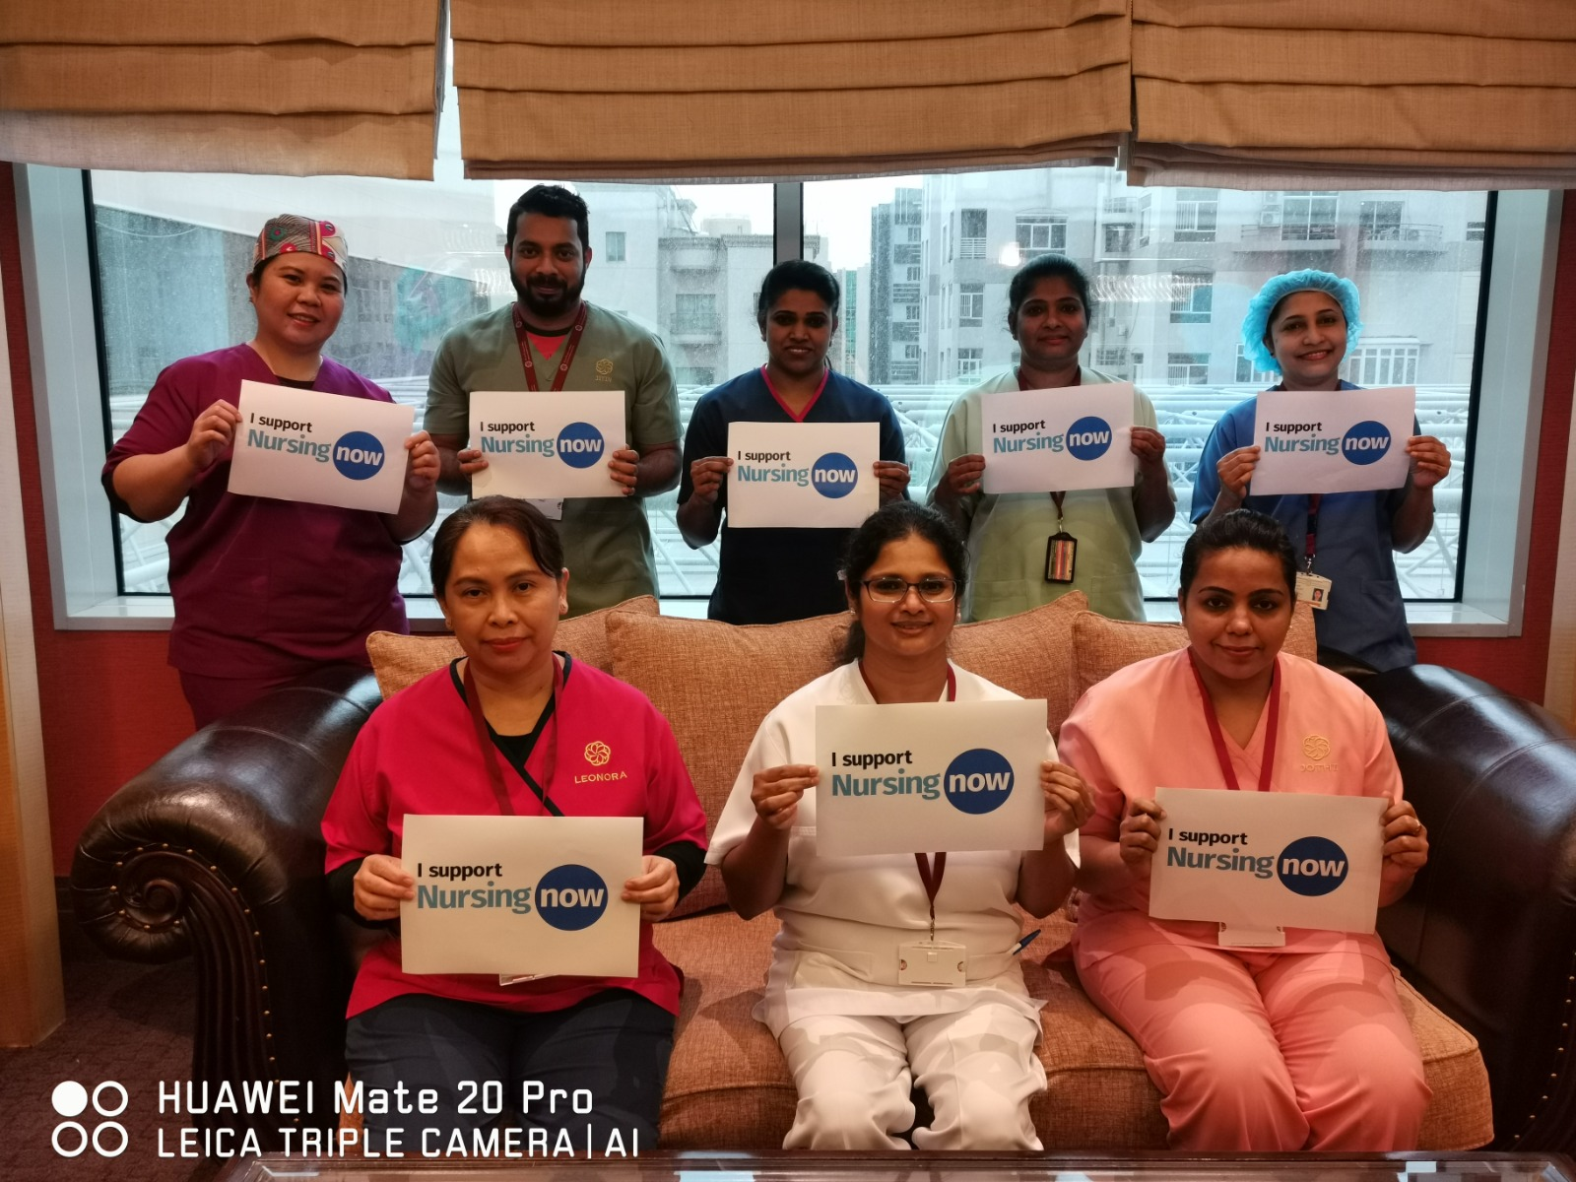

• Enhanced reputation, externally and with their own staff, as a good employer and for
investing in their workforce and championing nursing and midwifery
• Enhanced reputation as a champion of nursing and midwifery should help with recruitment and retention, including keeping your own ‘rising stars’
• Partnering with others locally and
internationally, to collaborate and to share
knowledge, ideas and learning to help develop each other’s healthcare systems
Credit: THET
Benefits for Employers
Credit: THET

Slide 5


Join the
NIGHTINGALE CHALLENGE
Champion influential leadership roles for nurses and midwives
Provide development opportunities for young nurses and midwives during 2020
Healthcare is changing fast and so should the workforce – invest in nurses and midwives, and prepare them for the future
Champion influential leadership roles for nurses and midwives
Provide development opportunities for young nurses and midwives during 2020
Healthcare is changing fast and so should the workforce.
Demonstrate that nursing and midwifery are exciting and rewarding careers

Slide 6
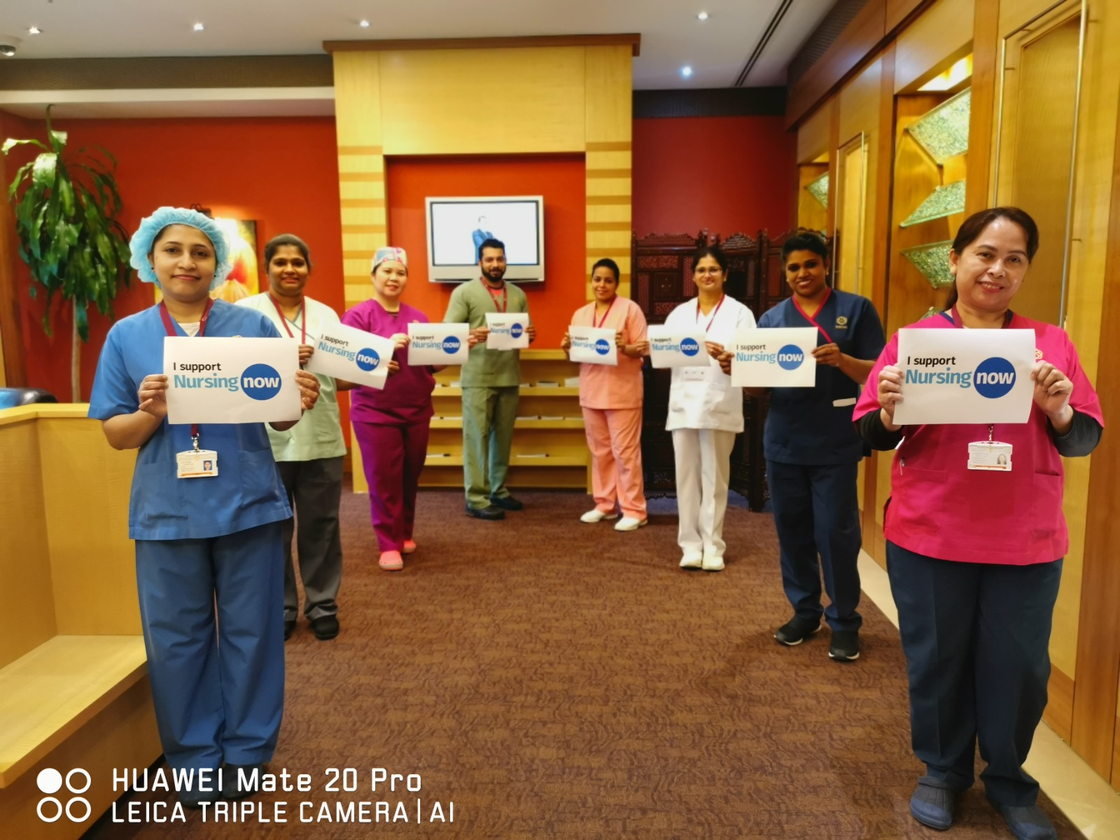

Credit: The Royal College of Nursing
Spread the word – help to raise the profile and status of nursing for the future.
Be agents for change – advocate for governments and health leaders to invest in nursing and midwifery
Get involved in 2020 Year of the Nurse and the Midwife

Slide 7
Curriculum- RHH Nightingale Challenge
♠ 1- Presentation- Individual
♠ 1- Dissertation – Group in 8/10
♠ 20 CNE / Internal
♠ 20 CNE / External
♠ 1 Poster Presentation- Group in 5

Slide 8
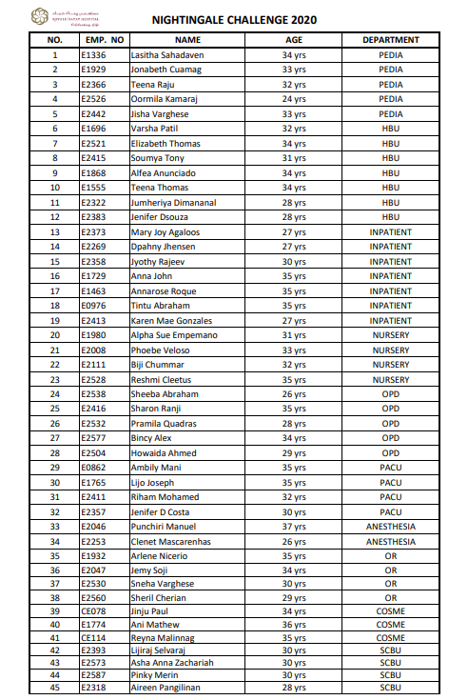

Slide 9
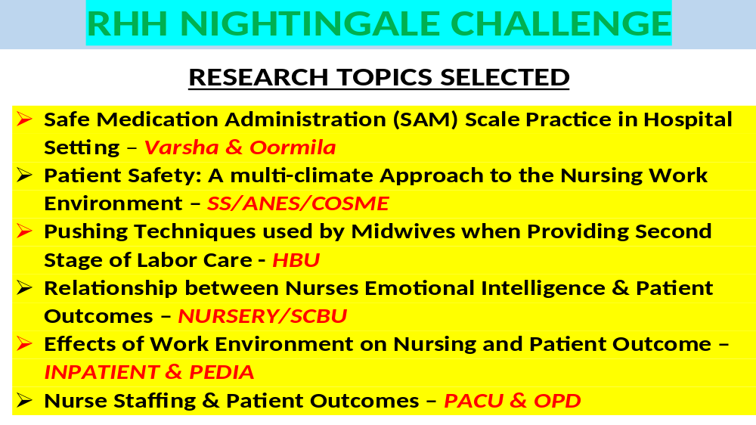

Slide 10
DECEMBER 2020 PRESENTORS
RHH NIGHTINGALE CHALLENGE TEAM
(1500-1600 every Monday & Tuesday)
# | PRESENTATIONS | STAFF NAME | AREA | VIRTUAL CLASS
1 | The Role of Transformational Leadership & Workplace Empowerment | SHARON RP | OPD | 7 DEC, MONDAY
2 | Stress Management: Healthcare Workers | OORMILA KAMARAJ | PEDIA | 7 DEC, MONDAY
3 | Nursing Process: Ida Jean Orlando | MARY JOY AGALOOS | IP | 7 DEC, MONDAY
4 | Self-Care Theory: Dorothy Orem | DAPHNY JHENSEN | IP | 8 DEC, TUESDAY
5 | Transcultural Nursing Theory: Madeleine Leininger | LIJO JOSEPH | PACU | 8 DEC, TUESDAY
6 | Teamwork in Healthcare | CLENET MASCARENHAS | SS-ANES | 14 DEC, MONDAY
7 | 21 Nursing Problems: Fay Abdella | PRAMILA QUADRAS | OPD | 14 DEC, MONDAY
8 | Current Challenges in Nursing | JENIFER D’SOUZA | HBU | 14 DEC, MONDAY
9 | The Helping Art of Clinical Nursing: Ernestine Weidenbach | JISHA VARGHESE | PEDIA | 15 DEC, TUESDAY
10 | Comfort Theory: Katharine Kolcaba | SHEEBA ABRAHAM | OPD | 15 DEC, TUESDAY
11 | The Core, Care & Cure: Lydia E. Hall | SNEHA VARGHESE | SS-OR | 15 DEC, TUESDAY
12 | Leadership Styles: Lewin & White | REYNA MALINNAG | COSME | 21 DEC, MONDAY
13 | Empowering Health System | SHERIL CHERIAN | SS-OR | 21 DEC, MONDAY
14 | Need Theory: Virginia Henderson | JENIFER D’ COSTA | PACU | 21 DEC, MONDAY
15 | International Patient Safety Goals | TINTU ABRAHAM | IP | 22 DEC, TUESDAY
16 | Adaptation Model: Callista Roy | KAREN MAE GONZALES | IP | 22 DEC, TUESDAY
17 | Interpersonal Theory: Hildegard Peplau | SOUMYA TONY | HBU | 22 DEC, TUESDAY

Slide 11
JANUARY 2021 PRESENTORS
RHH NIGHTINGALE CHALLENGE TEAM
(1500-1600 every Monday & Tuesday)
# | PRESENTATIONS | STAFF NAME | AREA | VIRTUAL CLASS
1 | HUMAN TO HUMAN RELATIONSHIP MODEL: JOYCE TRAVELBEE | LASITHA SAHADAVEN | PEDIA | 4 JAN, Monday
2 | NURSES’ ROLE IN HEALTHCARE ORGANIZATION | ASHA ANNA ZACARIAH | SCBU | 4 JAN, Monday
3 | POSTIVE PATIENT IDENTIFICATION | PUNCHIRI MANUEL | SS-ANES | 4 JAN, Monday
4 | 360 DEGREE PERFORMANCE EVALUATION AMONG NURSING PROFESSION | AMBILY MANI | PACU | 5 JAN, Tuesday
5 | HEALTH AS EXPANDING CONSCIOUSNESS: MARGARET NEWMAN | PHOEBE VELOSO | NURSERY | 5 JAN, Tuesday
6 | EFFECTIVE INTERPERSONAL COMMUNICATION | ELIZABETH THOMAS | HBU | 11 JAN, Monday
7 | NURSES EMPOWERMENT FOR QUALITY IMPROVEMENT | JEMY SOJI | SS-OR | 11 JAN, Monday
8 | PROACTIVE APPROACH IN NURSING CARE | JONABETH CUAMAG | PEDIA | 12 JAN, Tuesday
9 | FUTURE OF NURSING, LEADING CHANGE & ADVANCING | JINJU PAUL | COSME | 12 JAN, Tuesday
10 | PROFESSIONALISM IN NURSING | ALFEA GRACIA ANUNCIADO | HBU | 18 JAN, Monday
11 | NURSING DIRECTING/DELEGATION | JYOTHY RAJEEV | IP | 18 JAN, Monday
12 | DEALING WITH WORK BURNOUT: HEALTHCARE SETTING | ANNA ROSE ROQUE | IP | 19 JAN, Tuesday
13 | ARTIFICIAL INTELLIGENCE IN NURSING | TEENA THOMAS | HBU | 19 JAN, Tuesday
14 | ETHICAL DILEMMA IN NURSING | VARSHA PATIL | HBU | 25 JAN, Monday
15 | CONFLICT RESOLUTION: HEALTHCARE SETTING | LIJIRAJ SELVERAJ | SCBU | 25 JAN, Monday
16 | COMMUNICATIONS IN NURSING | ARLENE NICERIO | SS-OR | 26 JAN, Tuesday
17 | POWER AND POLITICS IN NURSING | ANI MATHEW | COSME | 26 JAN, Tuesday

Slide 12
FEBRUARY 2021 PRESENTORS
RHH NIGHTINGALE CHALLENGE TEAM
(1500-1600 every Monday & Tuesday)
# | PRESENTATIONS | STAFF NAME | AREA | VIRTUAL CLASS
1 | MATERNAL ROLE ATTAINMENT THEORY: MERCER | RIHAM MOHAMED | PACU | 1 FEB, MONDAY
2 | GOAL ATTAINMENT THEORY: IMOGENE KING | BIJI CHUMMAR | NURSERY | 1 FEB, MONDAY
3 | ENVIRONMENT THEORY: FLORENCE NIGHTINGALE | JUMHERIYA DIMANANAL | HBU | 2 FEB, TUESDAY
4 | STRESS AND RESILIENCY IN WORKPLACE | RESHMI CLEETUS | NURSERY | 2 FEB, TUESDAY
5 | CARING IS THE ESSENCE OF NURSING PRACTICE: JEAN WATSON | AIREEN PANGILINAN | SCBU | 8 FEB, MONDAY
6 | PERSONAL PHILOSOPHY OF NURSING IN CAREER | BINCY ALEX | OPD | 8 FEB, MONDAY
7 | NURSES JOB SATISFACTION | ALPHA SUE EMPEMANO | NURSERY | 9 FEB, TUESDAY
8 | CODE OF CONDUCT FOR NURSES | PINKY MERIN | SCBU | 9 FEB, TUESDAY
9 | NURSING MANAGEMENT | HOWAIDA AHMED | OPD | 15 FEB, MONDAY
10 |  | TEENA RAJU | PEDIA | 15 FEB, MONDAY
11 | ENGAGING IN PATIENT SAFETY | ANNA JOHN | IP | 15 FEB, MONDAY

Slide 13


Slide 14
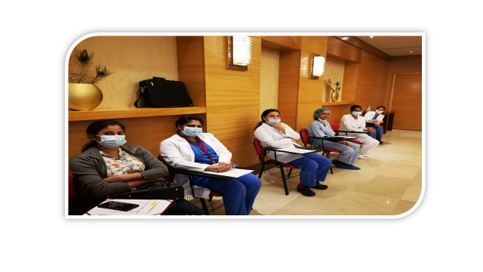
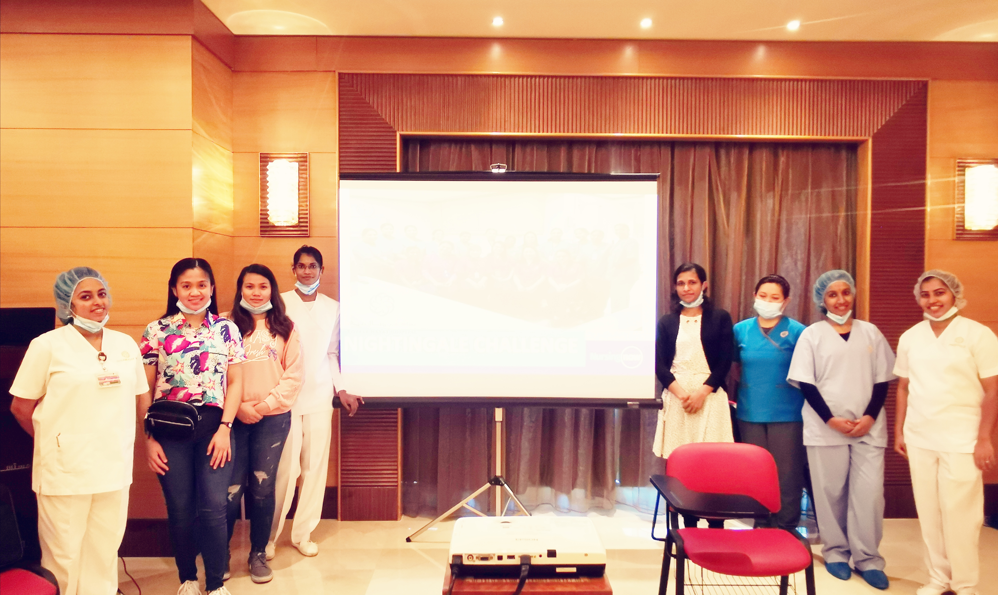
MEETINGS

Slide 15
