Slide 1
“Lack of funding in field of recovery & rehabilitation - what does this mean for evidence based practice and patient care?”
Liz Lightbody
Professor of Stroke Care and Improvement
University of Central Lancashire & Lancashire Teaching Hospitals NHS Trust
celightbody@uclan.ac.uk
Notes:
Good morning and I would like to thank Nursing now and Same You for inviting me to give this talk today

Slide 2
This presentation covers
Funding challenges
Evidence based practice
NIHR Global Health Research Group
Potential benefits: technology in the stroke pathway
Notes:
So within the presentation I am going to discuss stroke research but the concepts are transferable to other types of brain injury
I am going to discuss funding challenges but from the perspective underpinning evidence for care
Discuss some nursing research that we are undertaking in India
Discuss the potential for technology enhanced solutions across the pathway

Slide 3
Lack of Funding
More competition for scarce resources
Providers - the healthcare organisations and services (commissioners)
interventions/services that improve health and wellbeing
evidence and obtained from research
tacit knowledge
Challenge
creation of knowledge that is "useful“
undertaking research that is relevant
developing opportunities to create and share knowledge
Notes:
More competition for scare resources – it isn’t a bottomless pot and we all have to fight for the resources available
Provides of care and those who commission services – what to know that what they are providing or commissioning adds value and that might be in terms of improved patient outcomes or experience or worker smarter or more efficiently
In order to provide that evidence base we need robust research, informed by the tacit knowledge obtained from the experiences of healthcare professionals in their daily practice.
Because in order to produce change in clinical practice knowledge or evidence must be perceived as "useful knowledge"
challenge is creating knowledge that is "useful", including commissioning and performing research that is highly relevant to nurses in their daily practice, and developing opportunities for nurses to create and share their tacit knowledge, such as through action research groups.

Slide 4
Ideally
All evidence implemented in practice
Good clinical practice in place
Recognition of gaps in evidence
Researching towards filling those gaps
Research priorities those of nurses & patients, carers and the public
The best care possible available to all!
Notes:
The ideal solution is that all evidence is implemented into practice in a timely manner, but we know that does happen and it takes on average 15-20 years to get research implemented into practices
If we are implementing research finding we should have good clinical practice
Within clinical practice we want to recognise the gaps in evidence and be working towards researching those gaps
And if we have given nurses the opportunity to create and share their tacit knowledge – the research should be relevant to nurses but it also needs to be relevant to patients and carers and the wider public
If we do all of that then we should be providing the best care to all

Slide 5
The need to change
If you always do what you’ve always done
You will always get what you’ve always got
So if we are committed to improvement, then we need to make changes
But we must have evidence that new is better than the old
Notes:
If you always do what you’ve always done
You will always get what you’ve always got
So if we are committed to improvement, then we need to make changes be that implementing evidence into practice or identifying the evidence gaps
But before we change practice we need to know that what is being suggested is better than what we do now – and that requires research

Slide 6
NIHR GHRG on Improving Stroke Care in India

Slide 7
Aims and Objectives
Primary Objectives:
To investigate the feasibility and acceptability of the interdisciplinary care bundles to staff, service users and their families to inform further research
To develop three evidence-based Intervention Packages, focused on each of the care bundles:
Swallowing and hydration
Physiological and neurological monitoring
Education and training of relatives of those with acute stroke.
To estimate the:
proportion of people with dysphagia, dehydration, early neurological deterioration by 72 hours, abnormal physiological values
distribution of time from stroke admission to dysphagia screen

Slide 8
Why is dysphagia important?
There is robust evidence that the identification of dysphagia, its type and severity is essential in reducing:
The risk of pneumonia (Bray et al., 2016; Palli et al., 2017; Masrur et al., 2013; Titsworth et al., 2013; Finlayson et al., 2011; Westendorp et al., 2011; Lakshminarayan et al. 2010; Sellars et al., 2007; Hinchey et al., 2005; Martino et al., 2005)
Increasing length of hospital stay (Altman et al., 2010)
Mortality (Ingeman et al., 2011; Koennecke et al., 2011; Katzan et al., 2003; Vernino et al., 2003)
Poor outcomes (Turner et al., 2015; Middleton et al., 2011; Bravata et al., 2010;)
Costs (Katzan et al., 2007; Odderson et al., 1995).
Reduced well-being (Ayres A, et al 2016)

Slide 9
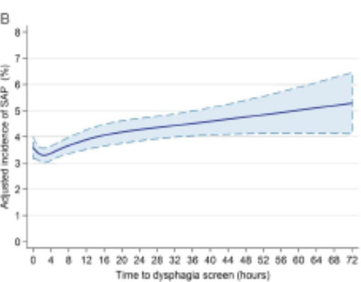
Swallow screen delay
Delays in dysphagia screening were associated with a 1% increase in stroke associated pneumonia
Reducing delays in screening for dysphagia in acute stroke should be a focus of quality improvement in stroke care
Multivariable model including level on consciousness. NIHSS, NIH Stroke Scale; SALT, speech and language therapist; SAP, stroke-associated pneumonia.

Slide 10
Is water enough?
Of 1,151 patients who failed the water swallow
test, FEES showed:
- 648 (56%) Normal food
- 289 (25%) Puree food
(Suiter and Leder 2008)
In poor resourced areas no SALT – management

Slide 11
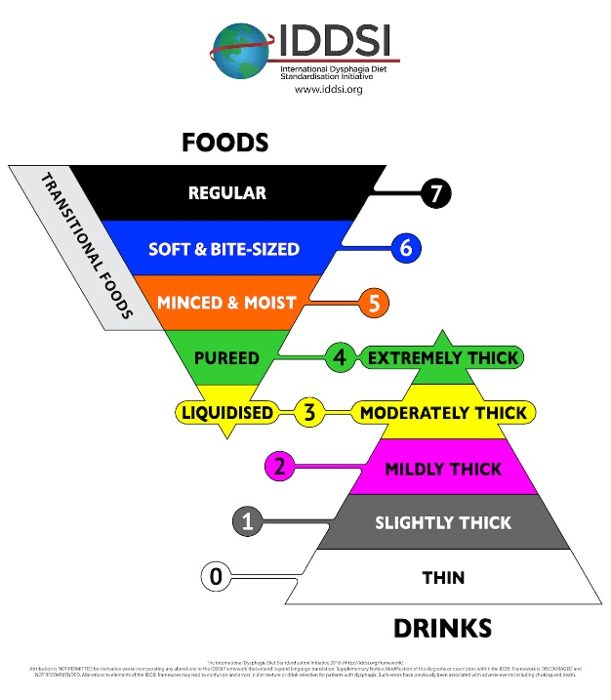

Slide 12
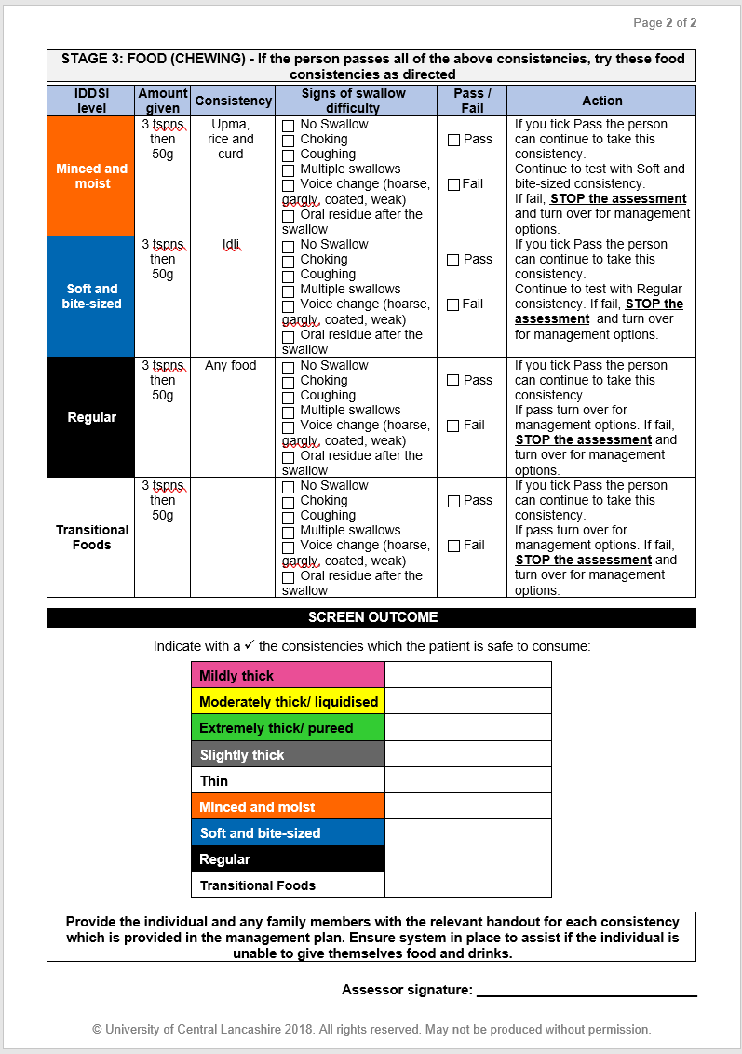
IMPROVISE Stroke Swallow Screening Tool

Slide 13
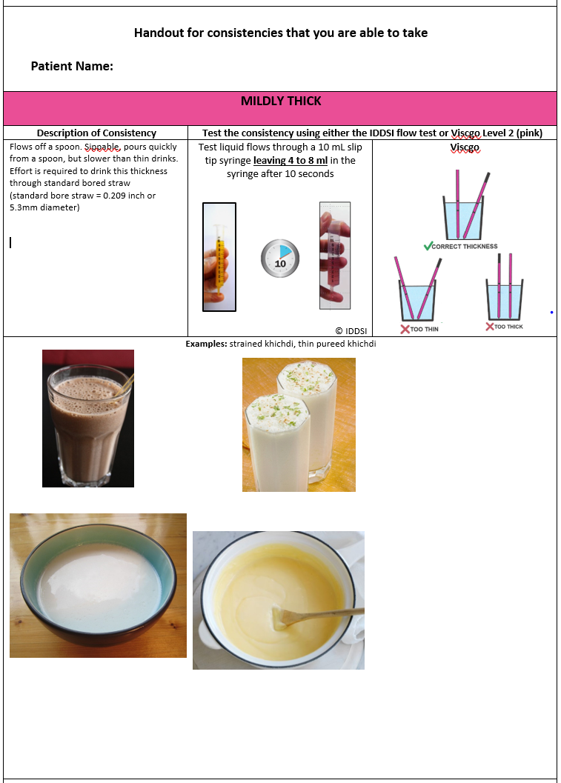
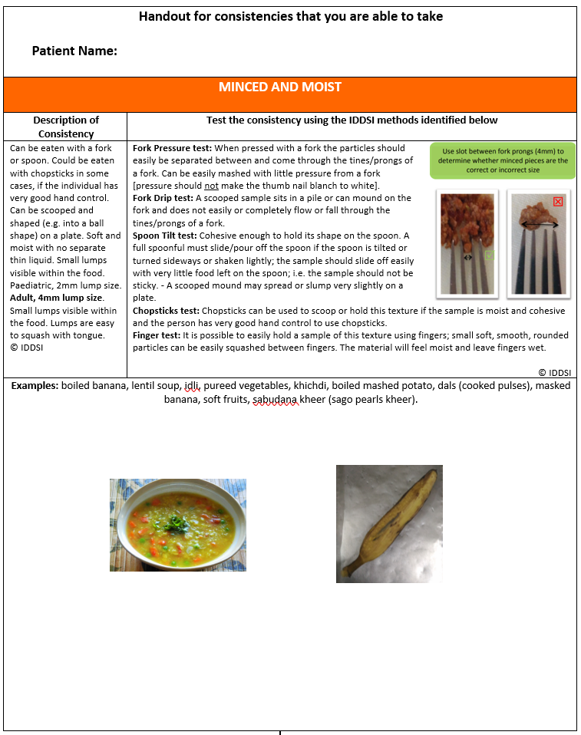
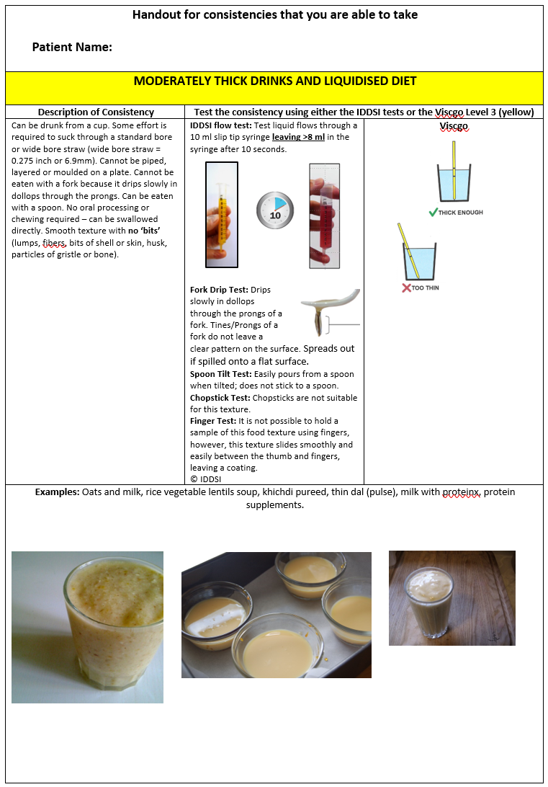
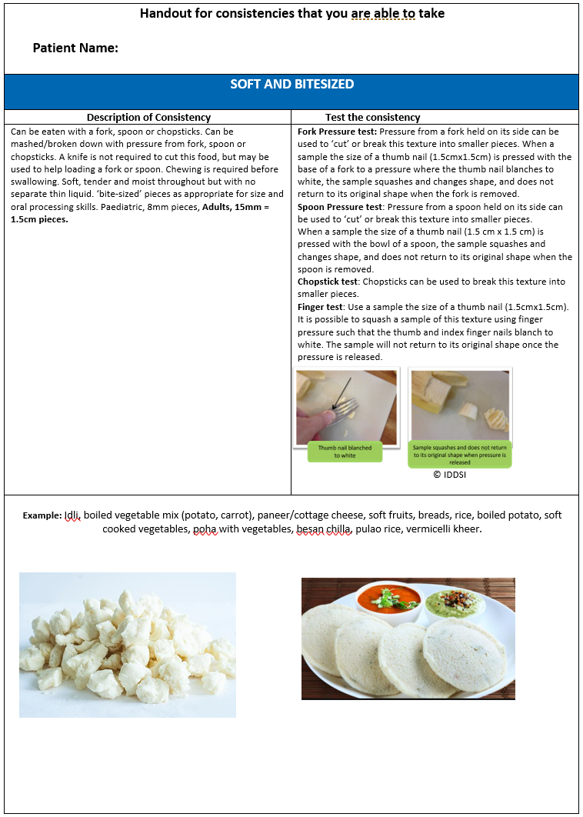
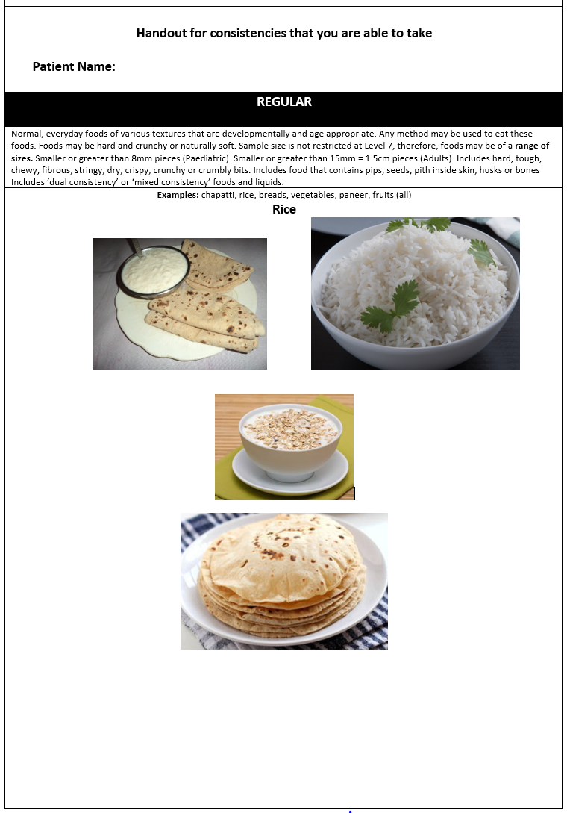
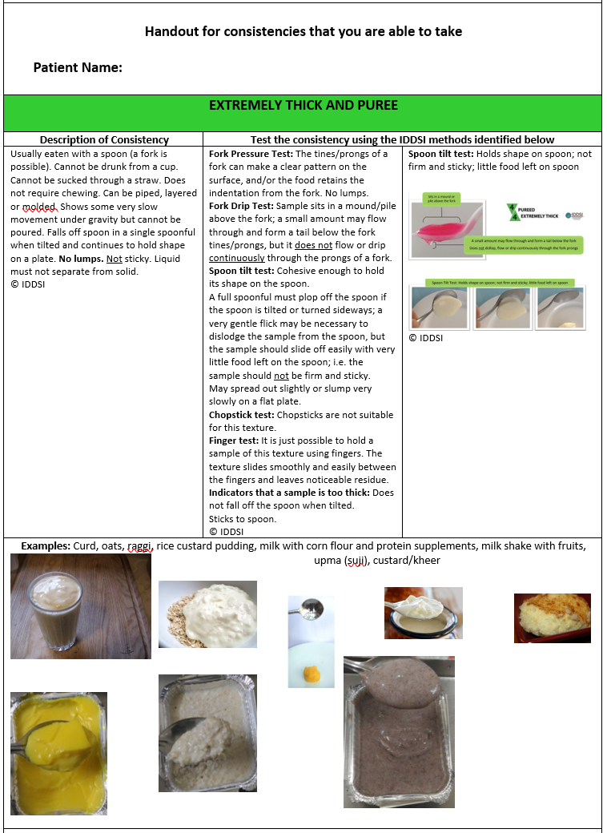
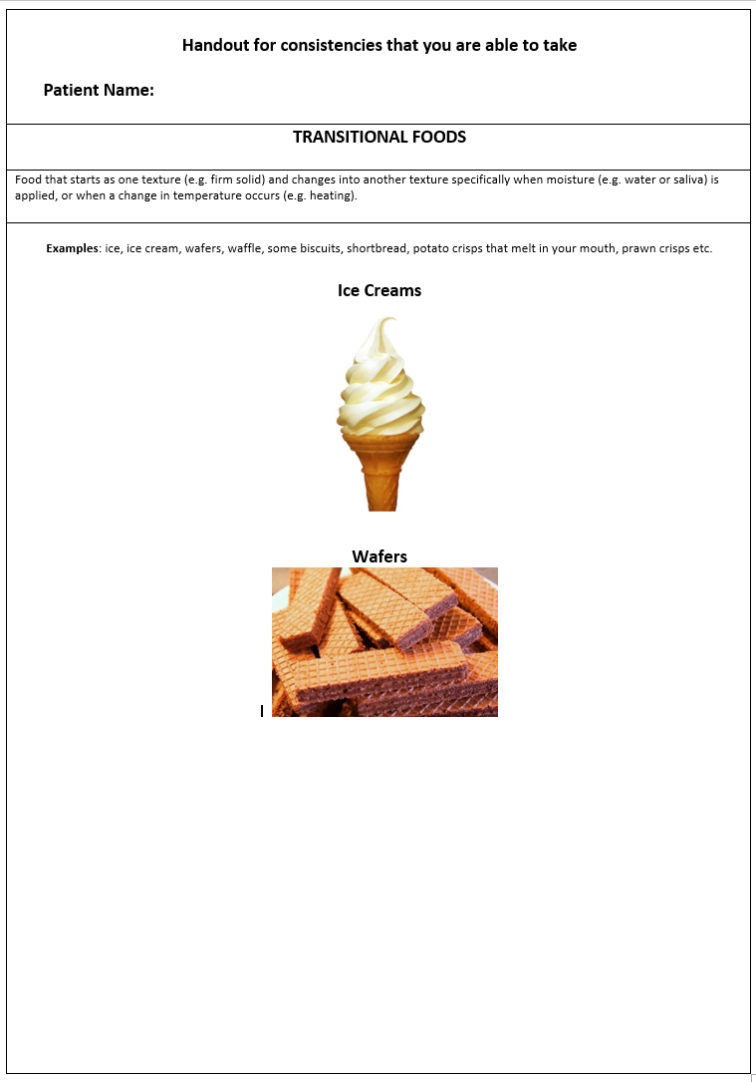
Management Intervention / Carer Instruction Sheet

Slide 14
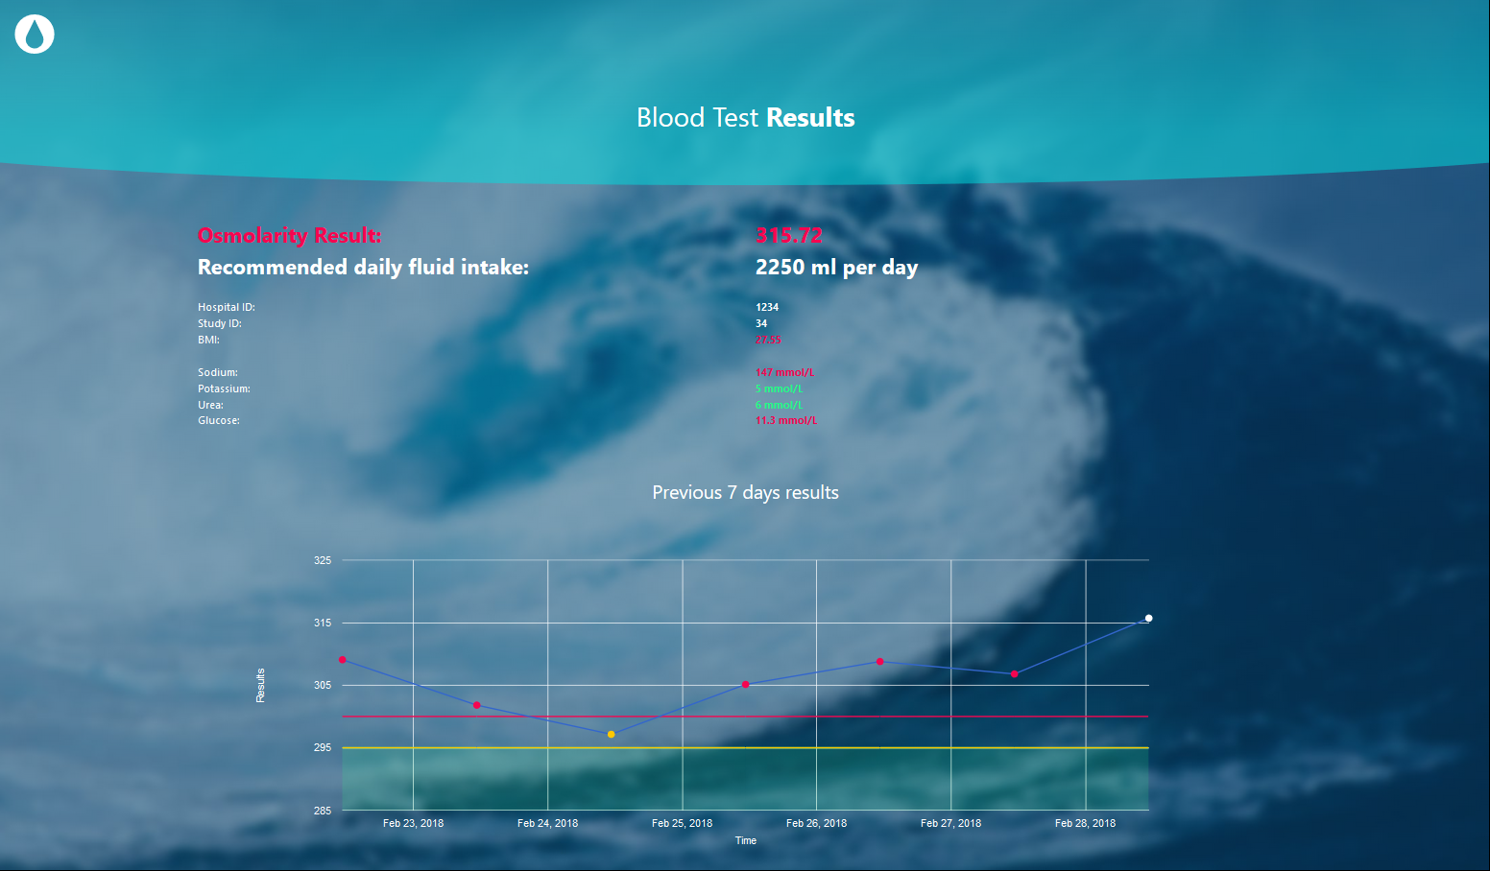
Hydration assessment and point of care tests
Clinical
Fluid charts
Urea:Creat Ratio Osmolarity App
Urine Specific Gravity USG)
Urine
colour
Notes:
POC tests for hydration compared to osmolality
specific gravity
Colour
skin turgidity
Estimate osmolarity from U&Es and venous blood glucose

Slide 15
Osmolarity Calculator App

Slide 16
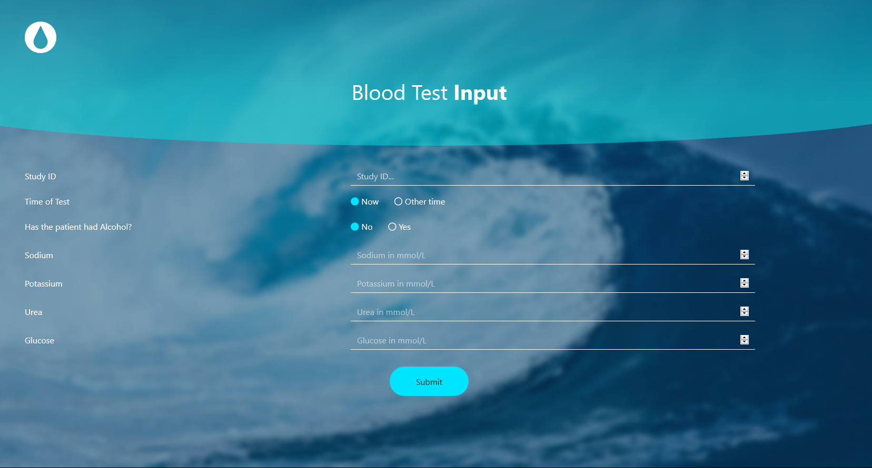

Slide 18
Information Technology
Key role in modern, complex healthcare
Demands could be mitigated by using information technology
Information technology can
reduce rate of errors
improve communication
make information more readily accessible
assist in diagnosis and monitoring
provide decision support
enhance implementation of guidelines
support education and training
Notes:
Information technology plays a key role in modern, complex healthcare.
The heavy demands of stroke care could be mitigated to a degree by using information technology.
Information technology can reduce the rate of errors, improve communication, assist in diagnosis and monitoring, provide decision support, and enhance implementation of guidelines and recommendations and support training

Slide 19
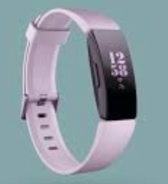
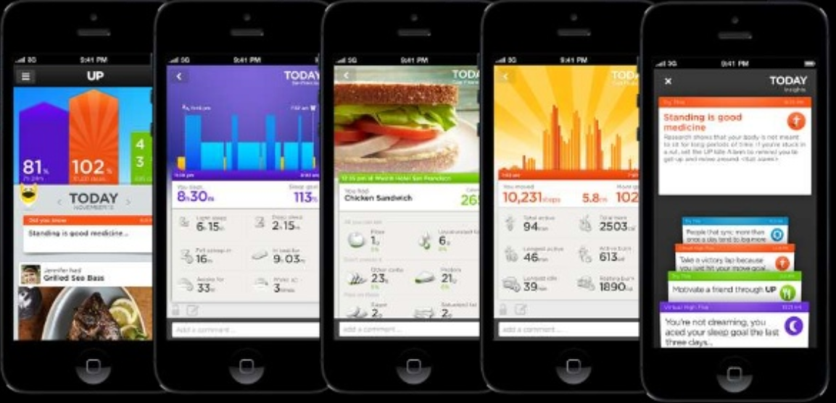
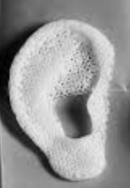
Technology impacting healthcare
Telemedicine
Technology enhanced learning
Facial recognition/Mood detection – tacking facial expressions
Apps
Wearable technologies (embedded)
Near field communication (monitoring)
Big data
Mobile diagnostics
Machine to machine
Smart pills
Biosensor tattoos (temperature/hydration levels)
3D printing and 3D bio-printing
Notes:
There are many technologies already impacting our health care
Our hyper-acute telemedicine toolkit and its evaluation, developed as part of Cumbria and Lancashire Tele-Stroke Network, has substantially increased eligible/treated patients with clot busting drugs at all 9 hospitals in the region. The toolkit, developed as part of our National Institute for Health (NIHR) Research for Patient Benefit project grant (~£250K), and has been adopted across the UK in areas where stroke consultants are in short supply (so not available 24/7 at each hospital), and where geographical challenges make it difficult to redirect patients to hospitals with a stroke specialist available.
Our on-line and technology enhanced delivery of the NETSMART training programme for stroke specialist nurses, making them advanced practitioners, has allowed nurses to take a place on the Tele-stroke rota alongside physicians
Whilst clot busting drugs are important aspects of care it is co-ordinated stroke unit care that is likely to have the greatest impacts
40% of patients go worse
50% of patients have complications
Effective assessment and management could be achieved in a cost effective manner if we could harness the correct technologies

Slide 20
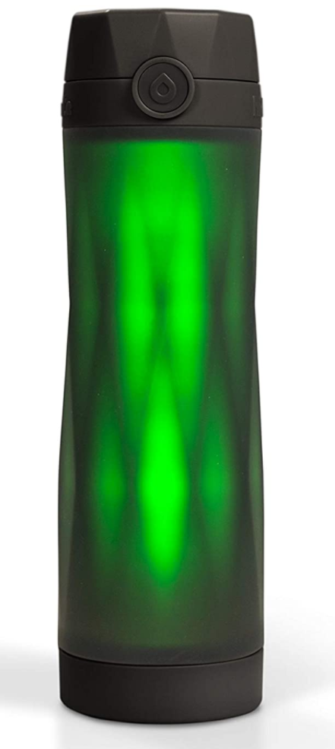
Hydration
Sensor technology tracks your water intake
Syncs your progress to a hydration tracker app
Integrates with other activity trackers to adjust your daily water goal
Illuminates the entire bottle to remind you to drink more water
at regular intervals
behind on your daily water goal
Notes:
I noticed this the other day
Potential for use in preventing dehydration 36% of people are dehydrated within 24 hours of admission and 62% are dehydrated at some time during their stay

Slide 21
Technology
Aspects of stroke management
Health monitoring
Healthcare delivery
AI – interpretation support
Rehabilitation aids and
adaptions
Patient monitoring devices
Education and training
More efficient and cost effective care
Decision support
Data platforms
Notes:
There are various aspects of the pathway that might be enhanced through technology making it more efficient and cost effective
Health monitoring (ECG monitoring; hospital/post-discharge, blood pressure, oxygen saturation)
Healthcare delivery (tele-consultation, cannulae, infusion pumps)
Decision-support (shared decision-making, information/evidence provision)
Wearable monitoring (Bladder function, blood sugar)
Rehabilitation aids/adaptations (communications aids, digital implants)
Education and training (tele-networks, web-based modules, simulation)

Slide 22
Research / Health Technology
Meets the needs of health services
Proven to be cost effective
Evidenced based
Clinical studies
Meets the needs of health care users
Notes:
HT is essential when it meets the needs of providers and users
It needs to be cost effective
And it needs to be evidenced based and in order to do that we need clinical trials

Slide 23
Conclusion
Nurses we are still developing an evidence
We need better methods to detection complications
More research on implementation
Research base to inform decision making
Opportunity to transform stroke services
Tailored technological and organisational solutions
Utilisation of technologies to deliver efficiencies (patient pathways/workforce)
Implementation – identifying adoption challenges and ways to overcome them
Notes:
As stroke nurses we are still developing an evidence base for specific interventions, we need better methods to improve the detection of complications and more research on specifics of implementing evidence into practice. We are starting to develop research base to inform decision making with a view to enhancing patient care and improving outcomes, but we still have much more research to do.

Slide 24
Key Message
Today’s research is tomorrow’s care……

Slide 25
Thank you for your attention Any questions?

