Slide 1
NIGHTINGALE CHALLENGE 2020

Slide 2
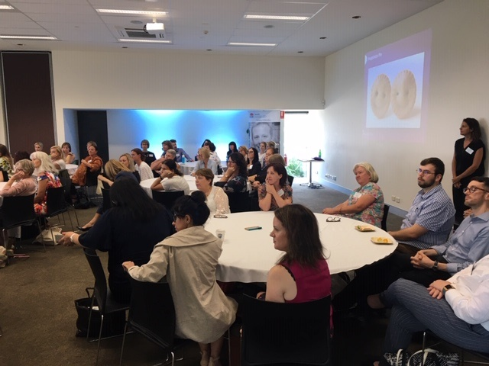
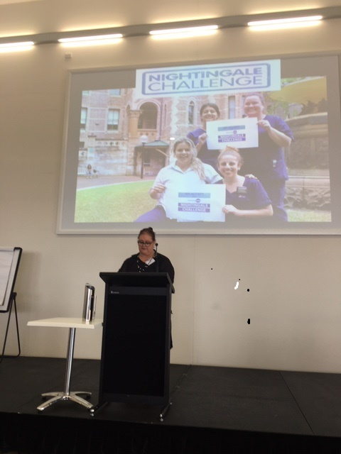
SESLHD Launches The Nightingale Challenge
SESLHD supports leadership development of Early Career Nurses and Midwives
The Nightingale Challenge was launched at the annual Nursing & Midwifery Forum by Ms Kim Olesen SESLHD, Director of Nursing & Midwifery

Slide 3
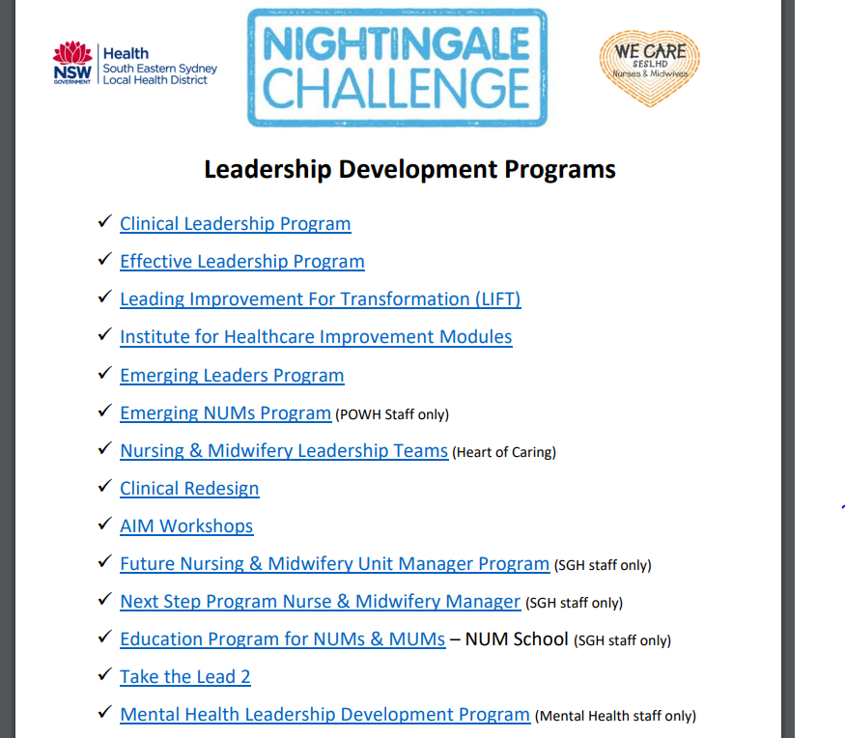
Leadership Programs
SESLHD has a broad range of Leadership Programs to match the development needs of our Early Career Nurses & Midwives

Slide 4
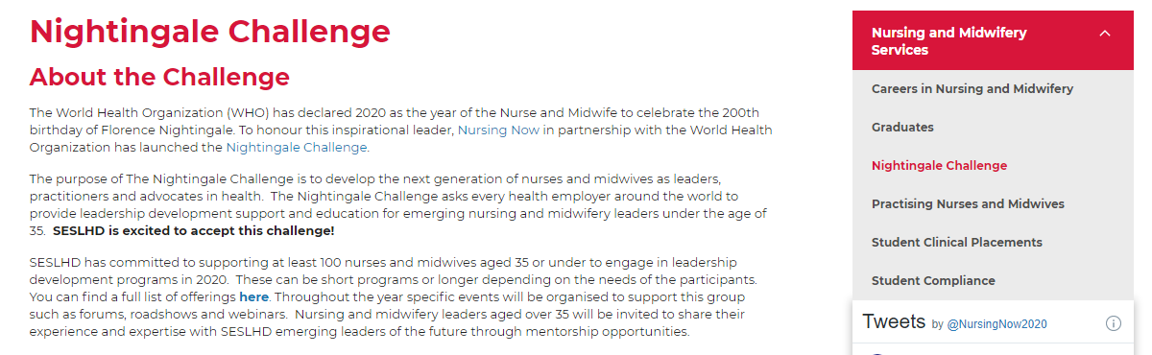
Setting up the structure for the challenge
A governance committee was developed to support the implementation of the Nightingale Challenge
Membership includes DON’s educators, Nursing and Midwifery Mangers & participants of the challenge
A local Nightingale Challenge website was developed with links to the Nursing Now website, a local Facebook page and a guide to mentorship
Click here to view the SESLHD Nightingale Challenge Website

Slide 5
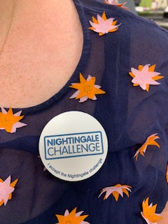
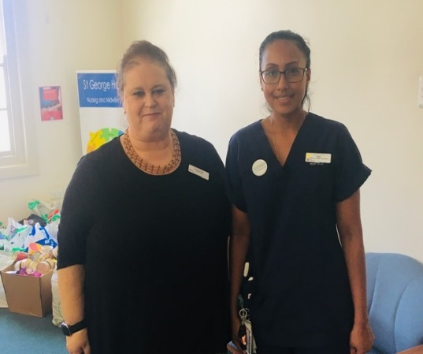
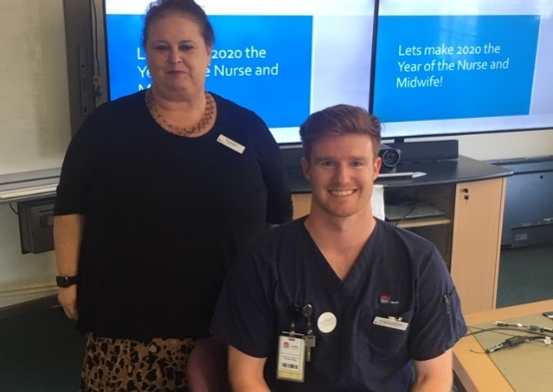
Participant recruitment
Participants enrolling in the program receive a badge from area DONM Kim Olesen
There are currently 40 participants enrolled in the challenge
Next steps are to collect stories from them of their leadership experiences so far
Develop Nightingale Challenge network and community of practice

