Slide 1
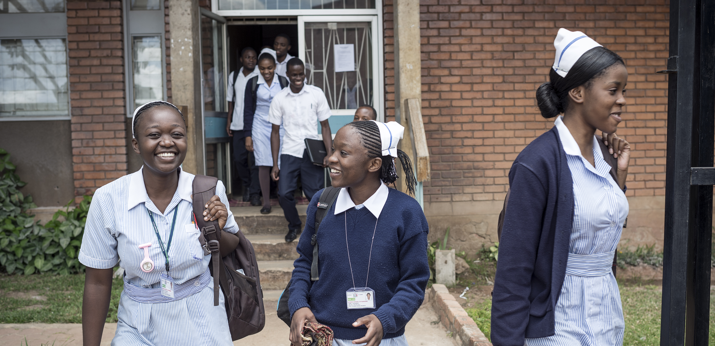
Nursing Now: A global campaign to improve health by raising the profile & status of nurses
October 2020
Credit: ICAP/Sven Torfinn

Slide 2
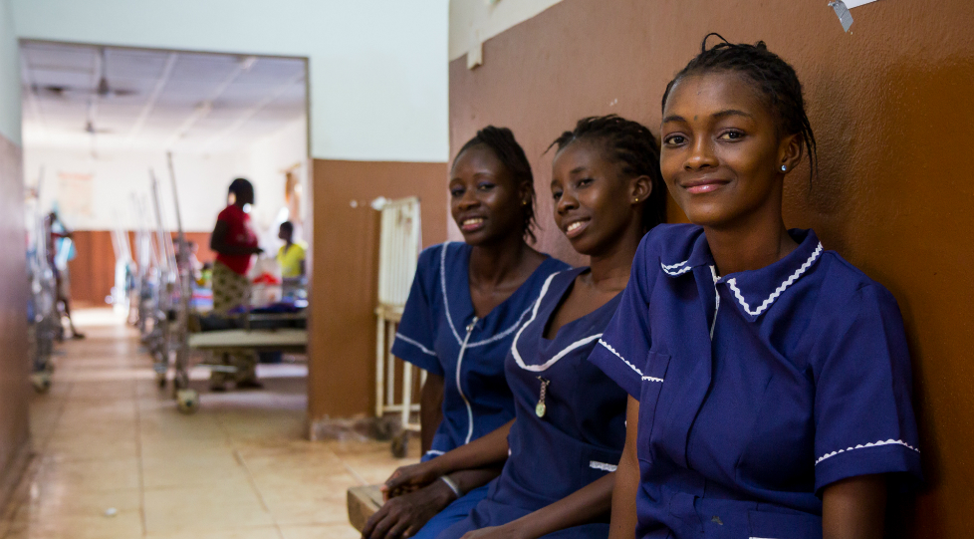

Who we are
A 3 year global campaign
In collaboration with International Council of Nurses and World Health Organization
Programme of the Burdett Trust for Nursing
Credit: Tim Bekir for THET
Credit: The Royal College of Nursing

Slide 3
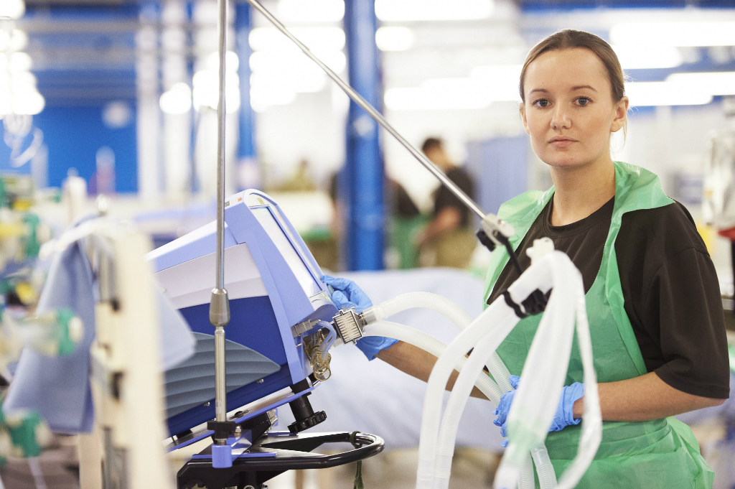
Triple impact
24 million nurses and midwives globally – half the professional health workforce
Systematically undervalued and unable to work to their full potential
Triple Impact – investing in nursing improves health, promotes gender equity & strengthens economies
Credit: Royal College of Nursing

Slide 4
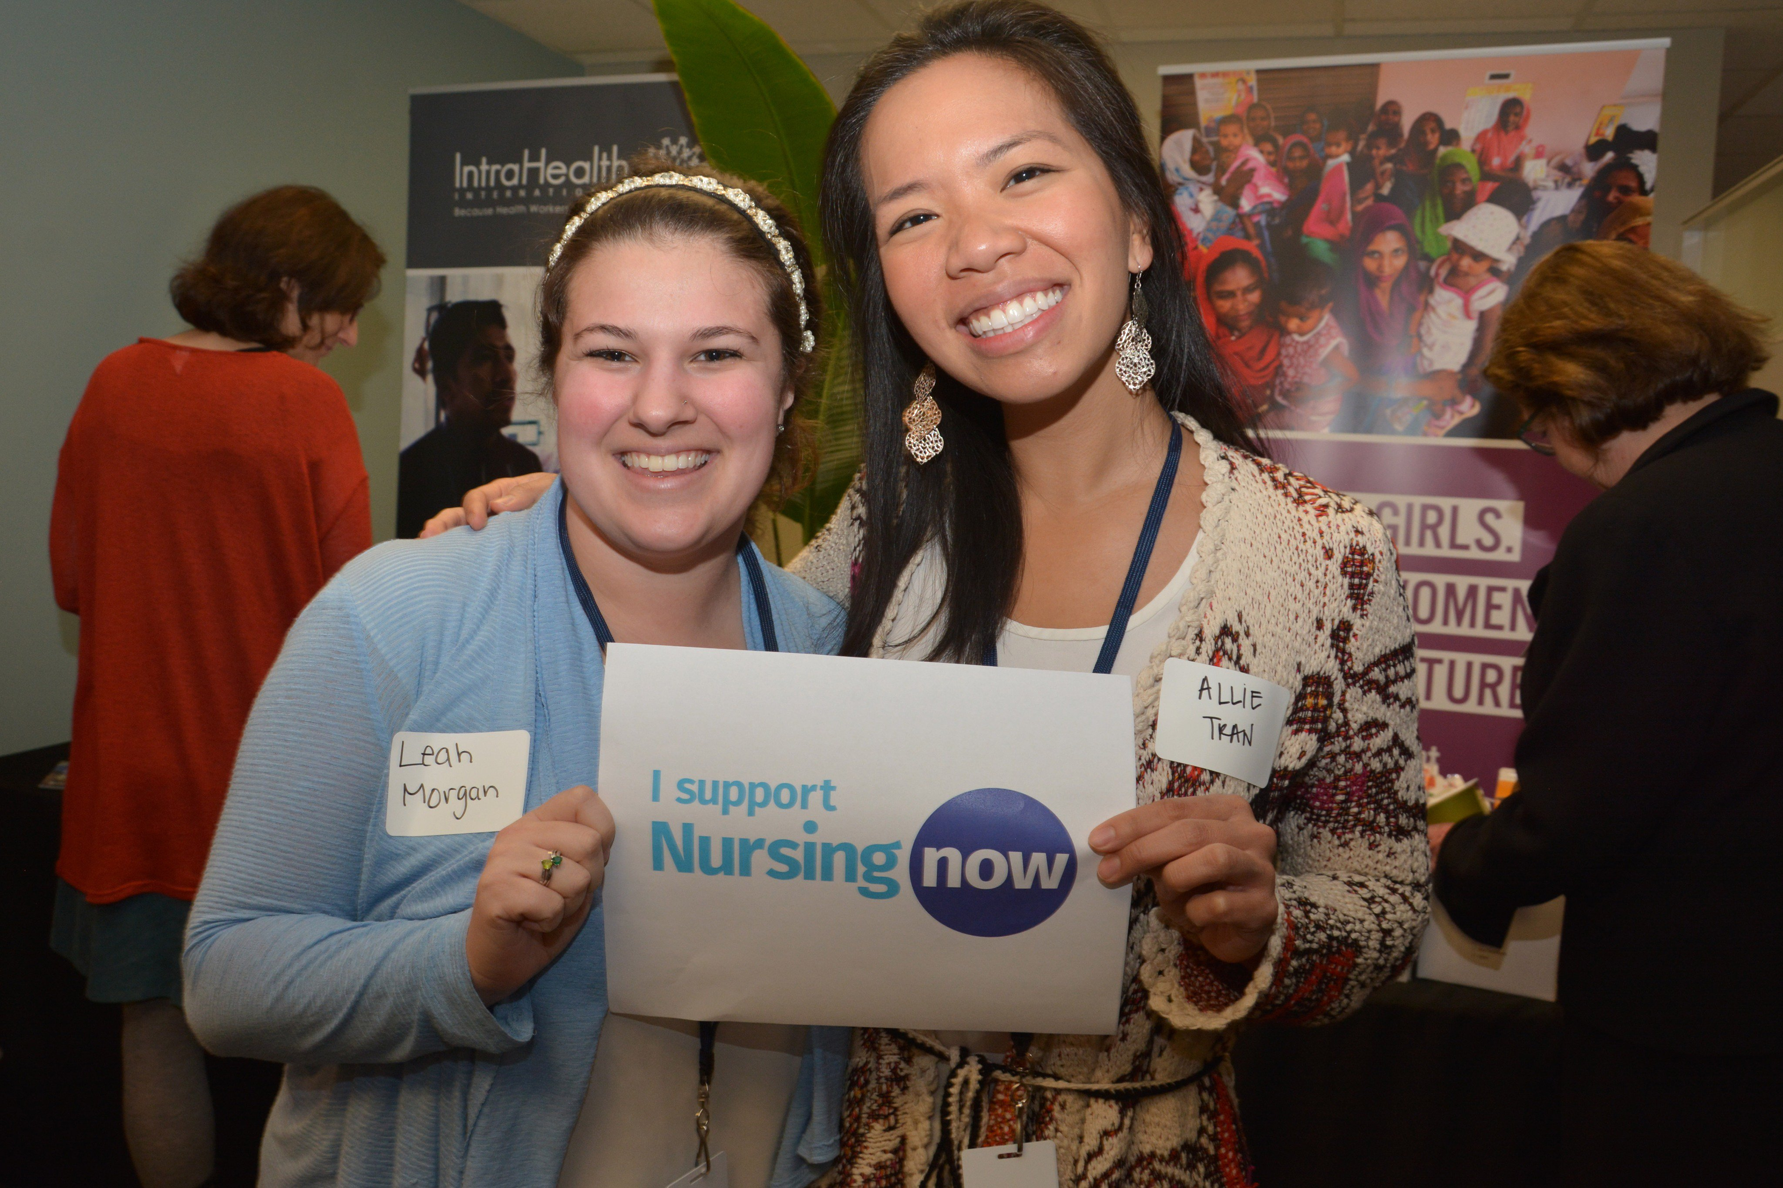
Our aim: to improve health globally by raising the profile and status of nursing.
Change policy globally and nationally
Promote influential leadership
Strengthen evidence of impact
Increase investment
Achieve triple Impact – health, gender and the economy

Slide 5
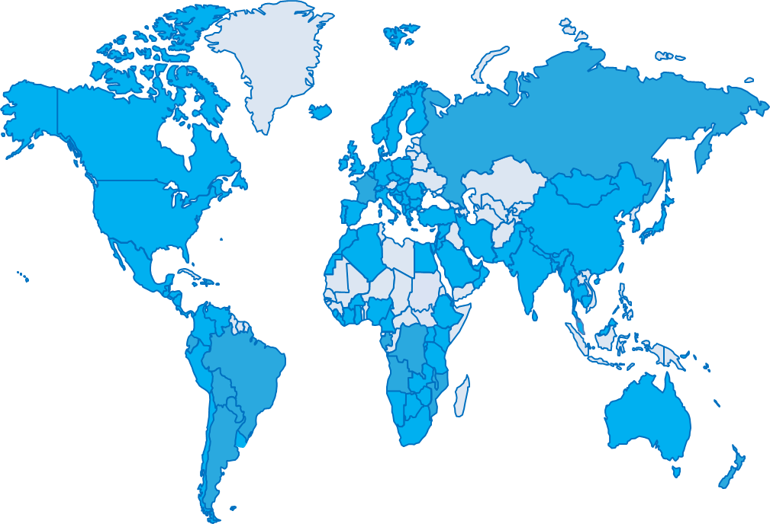
A growing global movement:
704 regional, national and local groups
Over 126 countries
September 2020
February 2018

Slide 6

Universal Health Coverage – health for all
Invest in and develop the nursing and midwifery workforce.
Keep the promise on #healthforall
- invest in nursing & midwifery.
The path to Universal Health Coverage requires action on the following:
Nurse-led clinics
More specialist nurses
Develop midwifery services
Primary health care
Health promotion and disease prevention

Slide 7
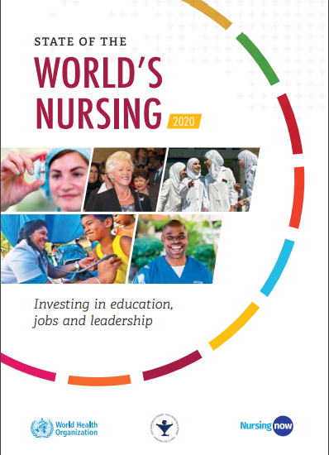
WHO’s first ever State of the World’s Nursing Report with the International Council of Nursing and Nursing Now
Findings identify important gaps in the nursing workforce and priority areas for investment in nursing education, jobs, and leadership to strengthen nursing around the world and improve health for all.
Credit: THET

Slide 8

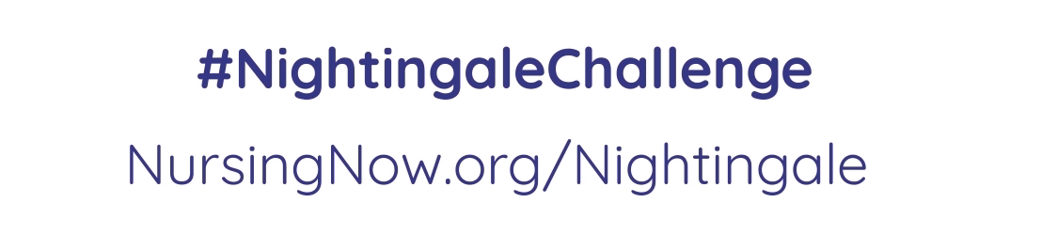
Join the
NIGHTINGALE CHALLENGE
Champion influential leadership roles for nurses and midwives
Provide development opportunities for young nurses and midwives during 2020
Healthcare is changing fast and so should the workforce – invest in nurses and midwives, and prepare them for the future
Demonstrate that nursing and midwifery are exciting and rewarding careers
Read more at nursingnow.org
Champion influential leadership roles for nurses and midwives
Provide development opportunities for young nurses and midwives during 2020 & beyond
Healthcare is changing fast and so should the workforce.
Demonstrate that nursing and midwifery are exciting and rewarding careers
LATEST NUMBERS:
30,530 nurses and midwives
785 employers
79 countries
48 partnerships

Slide 9



Join the
NIGHTINGALE CHALLENGE
Champion influential leadership roles for nurses and midwives
Provide development opportunities for young nurses and midwives during 2020
Healthcare is changing fast and so should the workforce – invest in nurses and midwives, and prepare them for the future
Demonstrate that nursing and midwifery are exciting and rewarding careers
Read more at nursingnow.org
How do we leverage the momentum of 2020 and Nursing Now to create a lasting legacy?

Slide 10
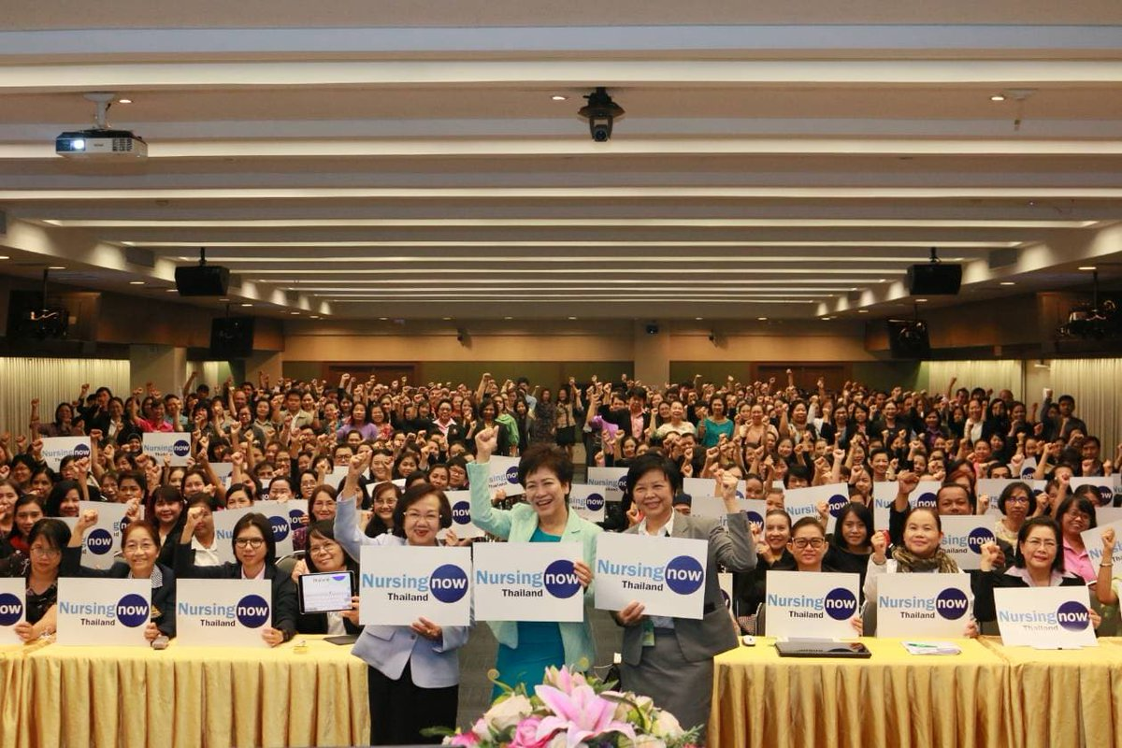
Partner with us
Credit: The Royal College of Nursing
Spread the word – help to raise the profile and status of nursing
Be agents for change – advocate for governments and health leaders to invest in nursing and midwifery
Say yes to the NIGHTINGALE CHALLENGE

Slide 11
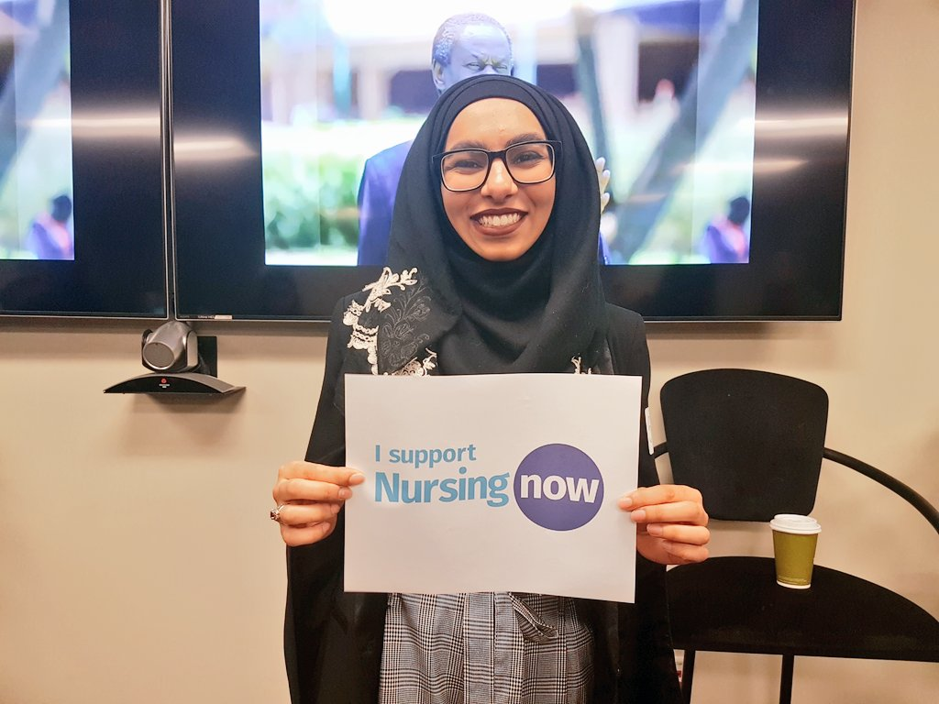
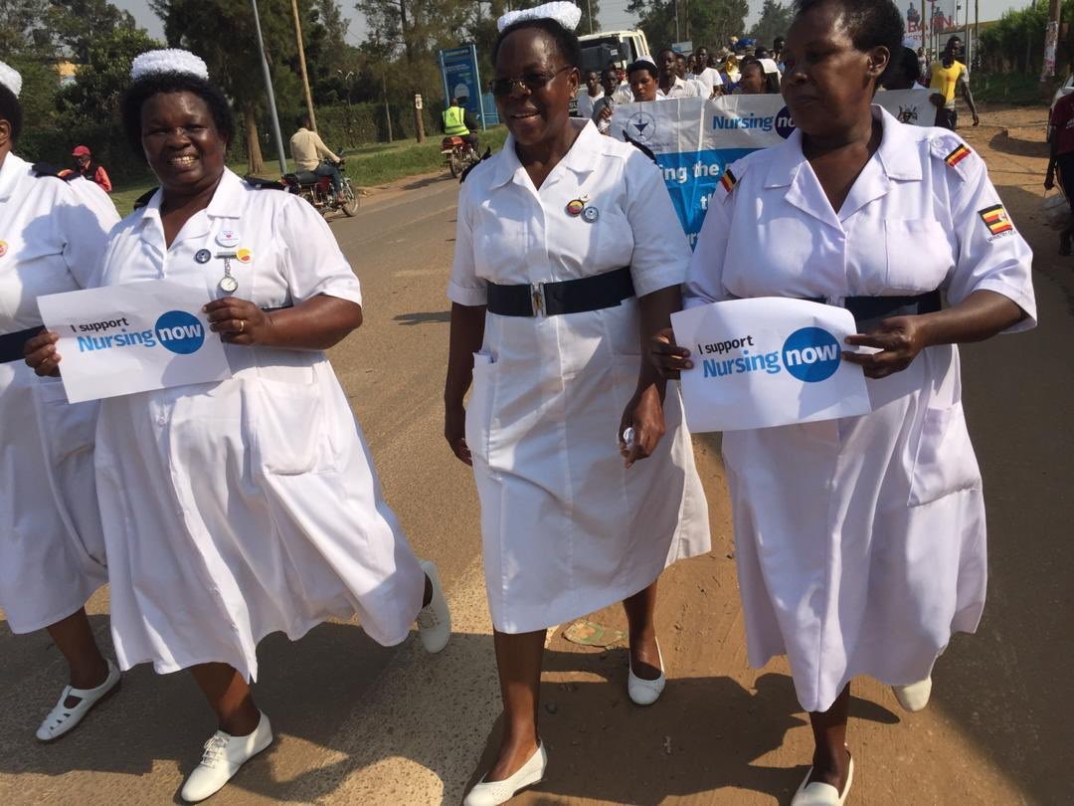
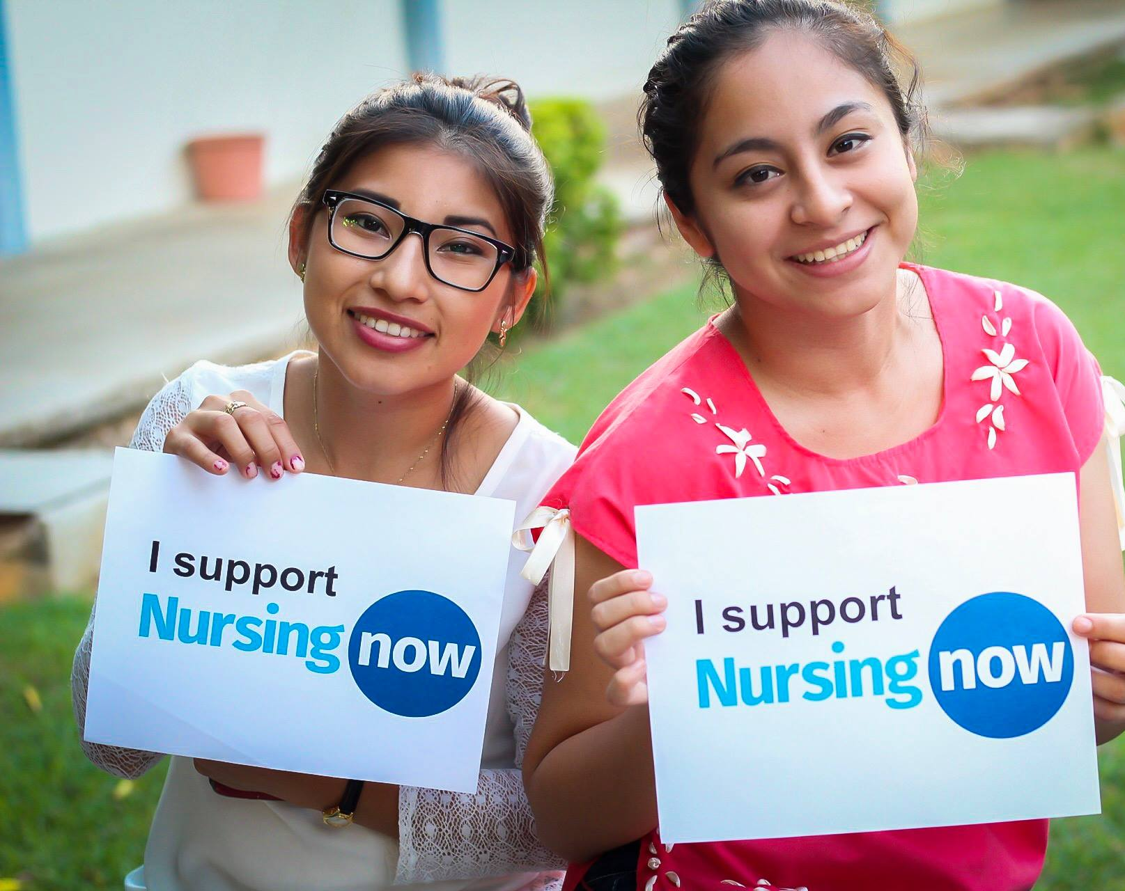
Thank you
www.nursingnow.org
info@nursingnow.global
@NursingNow2020
#Nurses2020 #Midwives2020
#NightingaleChallenge

